Slide 1
Data Insights
MAChine LEARning

Slide 2
Group Member
Devesh Upadhyay
Ritesh Kumar Singh
Shailendra Singh Kanshana
Sunny Kumar
Ashish Sengar
Akash Rathour

Slide 3
What is Data Insights
Data Insights is module which increase the accuracy of data and we use the concept of data preprocessing .We take data set that accuracy of detecting the diabetes patient 72 percentage . But By the use of machine learning we enhance the detecting percentage up to the 87 percentage.

Slide 4
Uses of Machine learning
Outliers
Attributes
Normalizing
Preparing the modal
Splitting data for training and testing
Creating the model

Slide 5
Pima dataset/diabetes data set --Attributes
Pregnancies
Glucose
Blood Pressure
Skin Thickness
Insulin
BMI
Diabetes Pedigree Function
Age
Outcome

Slide 6
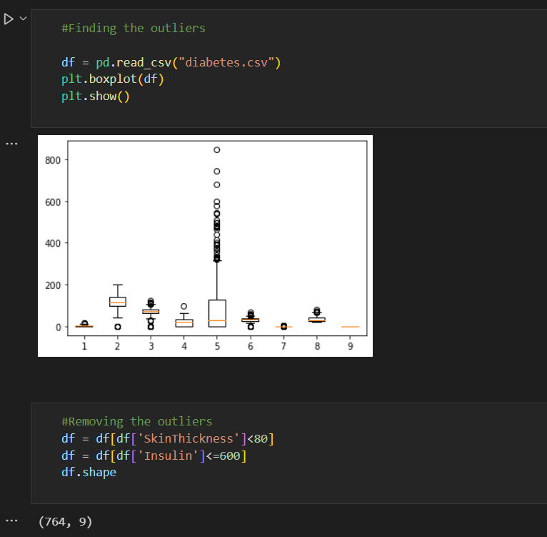
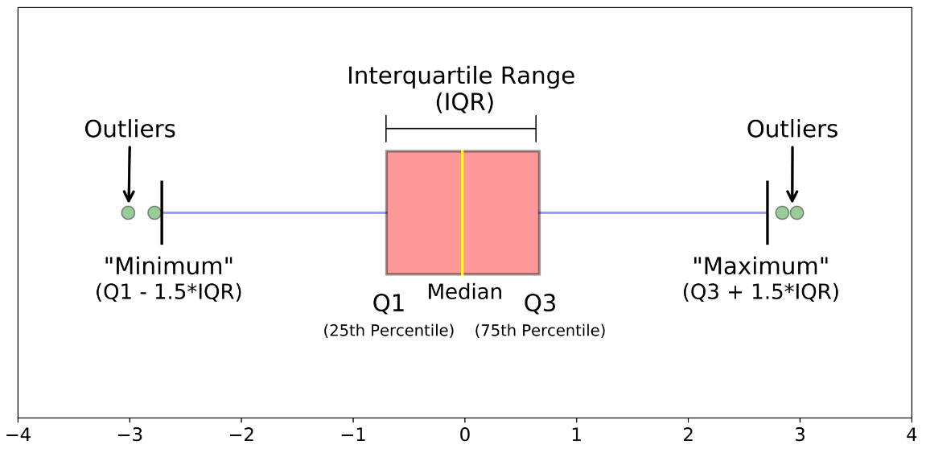
Outliers

Slide 7
Definition
Examination of the information for odd findings that are far away from the data collection. Such points are also classified as outliers. We exclude 4 outliers from our data set.
Uses
Outliers help in Fraud detection, fraudulent loan applications, Intrusion detection in the networks, Activity monitoring, Network performance, Satellite image analysis, Detecting novelties in images, Detecting mislabeled data, and many more.
Conclusion
Outliers should be properly investigated. They also provide useful information about the procedure under review or the process of collecting and documenting data. One should try to understand why they occurred and whether similar values are likely to continue to occur before contemplating the potential removal of these points from the results. Outliers are considered bad data points most of the time.

Slide 8
Removing ‘0’(zero) from attributes which can’t be zero
when we use any dataset for machine model then dataset should be clean.
if data set is not clean then accuracy of result will be low ,for high accuracy of result of model we have to clean data with some method.
From this dataset Value of some attributes can not be possible easily zero like Insulin, glucose, BMI, blood pressure , skin thickness

Slide 9
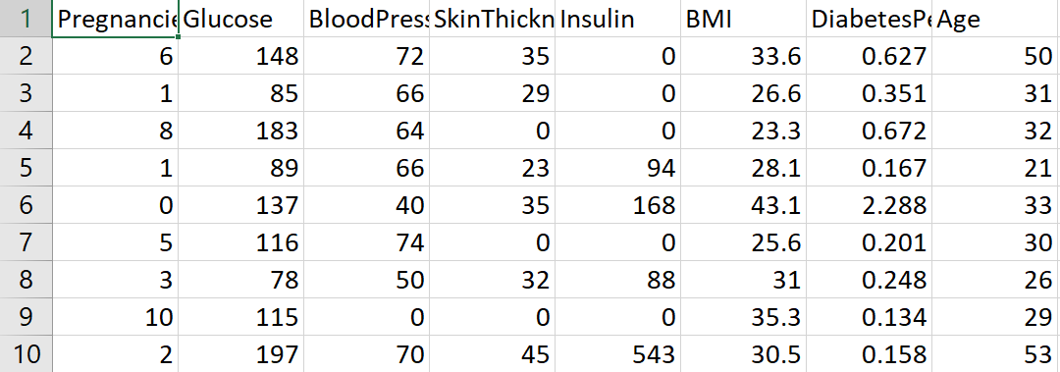
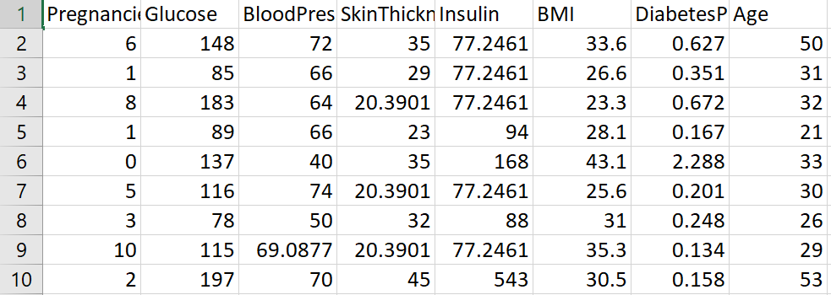
Replacing with mean value
where value of attribute will be zero value of that attribute will be replaced by mean value of that attributes.

Slide 10
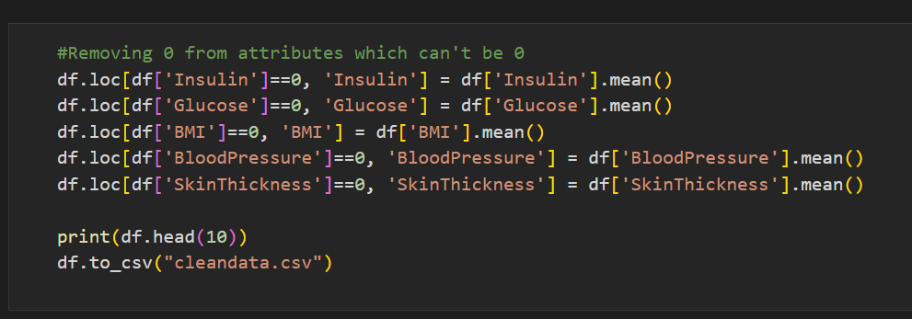
…………CODE ………….

Slide 11
Normalization of data
Normalization is a scaling technique in Machine Learning applied during data preparation to change the values of numeric columns in the dataset to use a common scale. It is not necessary for all datasets in a model. It is required only when features of machine learning models have different ranges.
Scaling to a range : means converting floating-point feature values from their natural range (for example, 100 to 900) into a standard range—usually 0 and 1 (or sometimes -1 to +1). Use the following simple formula to scale to a range:
X’ = (X - Xmin)/(Xmax - Xmin)

Slide 12
Why We Use Normalizing :
For Increase accuracy : Throw Two types of normalization
Min-Max Scaling – Subtract the minimum value from each column’s highest value and divide by the range. Each new column has a minimum value of 0 and a maximum value of 1.
Standardization Scaling – The term “standardization” refers to the process of centering a variable at zero and standardizing the variance at one. Subtracting the mean of each observation and then dividing by the standard deviation is the procedure:

Slide 13
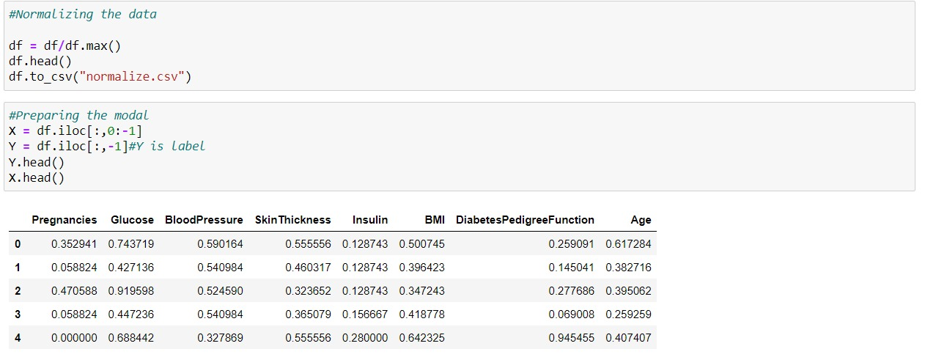
----→Code←----

Slide 14
Splitting data for training and testing
To use a dataset in Machine Learning, the dataset is first split into a training and test set.
The training set is used to train the model.
The test set is used to test the accuracy of the model
Typically, split 80% training, 20% test.

Slide 15
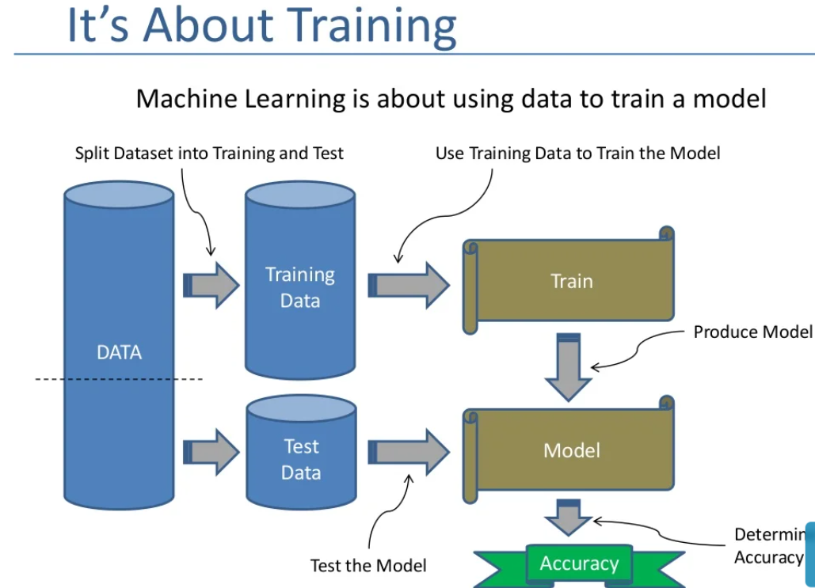
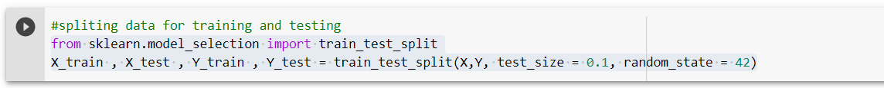
The test_size=0.1 denotes that the 10% of the data will be kept as the Test-set.
The remaining 75% will used for the training as the Training set.

Slide 16
Creating the Model
Logistic Regression is used to calculate or predict the probability of a event occurring.
Logistic Regression model could be apply determining that the person is diabatic or not or many more like the person is infected with COVID or not.
The range of outcome of the logistic regression lies between 0 to 1.
We can use logistic regression model in health care sector, financial industry and marketing.
Using the function _.fit(X,Y) we train the model and for testing the model we use the _.predict(X) function.
Now after the model is trained we find the accuracy of the model.

Slide 17
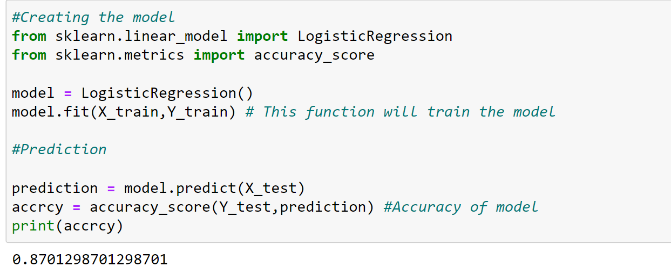
Before creating the model the accuracy percentage was 72% of detecting that the person is having diabetes or not.
After creating the model the accuracy percentage is 87% of detecting that the person is having diabetes or not.

Slide 18
Thank You

